Slide 1
MSIT 3860
Final Project Template

Slide 2
Part 1: Business Presentation
Presented by :- Gautam Mehta
mail id:- gmehta@clarku.edu

Slide 3
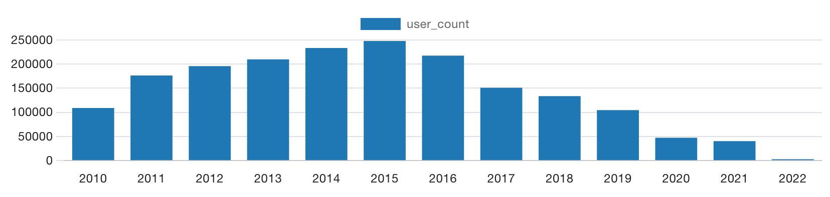
Yelp users since 2010
Quest 1:- How many users have joined Yelp each year since 2010?
Answer:- The results indicate a rise in the number of users from 2010, reaching a peak in 2015, followed by a subsequent decline that culminated in the lowest point in 2022.

Slide 4
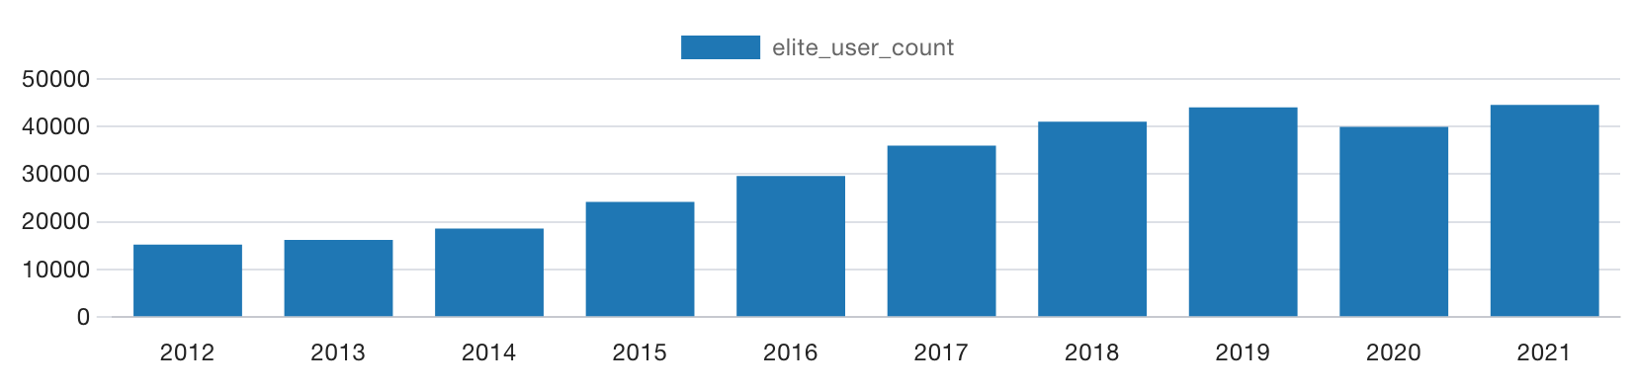
Elite user in each year between 2012 to 2021
Ques 2:- How many users were elite in each of the 10 years from 2012 through 2021? Does it look like the number of elite users is increasing, decreasing, or staying about the same?
Answer:- The findings suggest an increase in the user count starting from 2012. Between 2012 and 2017, the numbers showed a consistent upward trend, but from 2018 to 2021, the growth plateaued

Slide 5
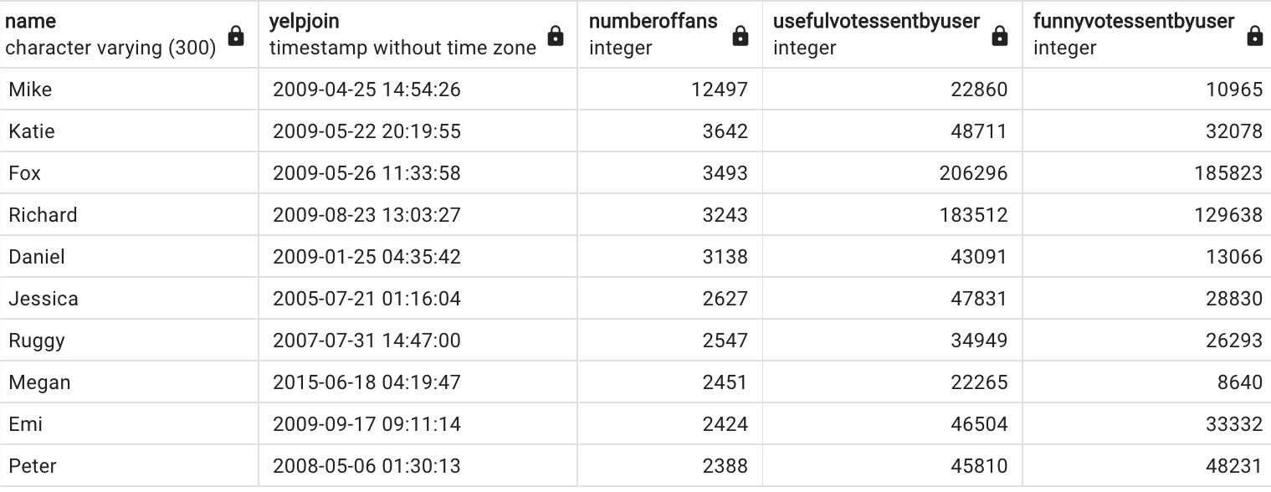
Users has the most 5-star reviews
Ques 3:- Which of our users has the most 5-star reviews of all time? Give us the person’s name, when they joined Yelp, how many fans they have, how many funny, useful, and cool ratings they’ve gotten.
Answer:-
Presented is a list of users who have consistently given the highest possible rating of 5 stars in their reviews over time.

Slide 6
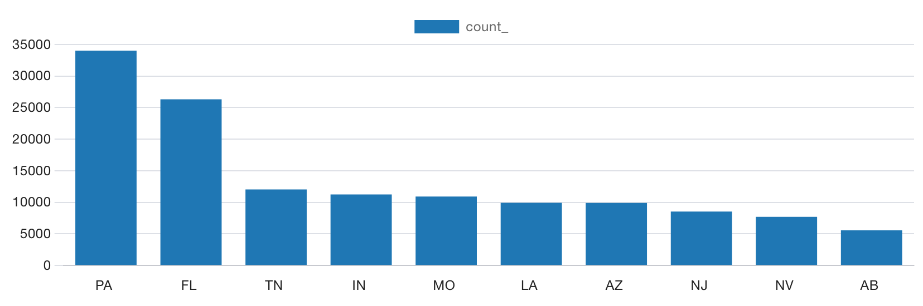
Top 10 US states with most businesses
Ques 5:- Which US states have the most businesses in our database? Give us the top 10 states
Answer:- The results indicate that Pennsylvania (PA) has the highest number of businesses, followed by Florida(FL), while Alberta (AB) has the fewest businesses.

Slide 7
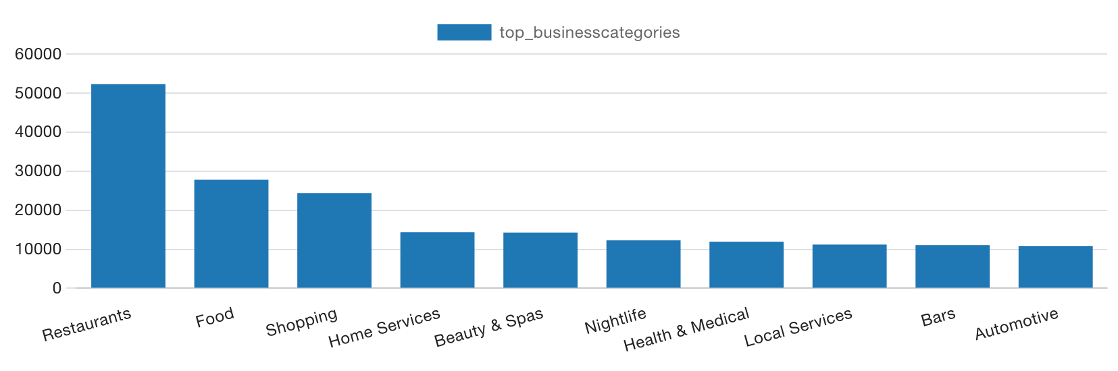
Top ten business categories
Ques 6:- What are our top ten business categories? In other words, which 10 categories have the most businesses assigned to them?
Answer:- The results indicate that Restaurants is on the top followed by Food and automotive at the 10 position.

Slide 8
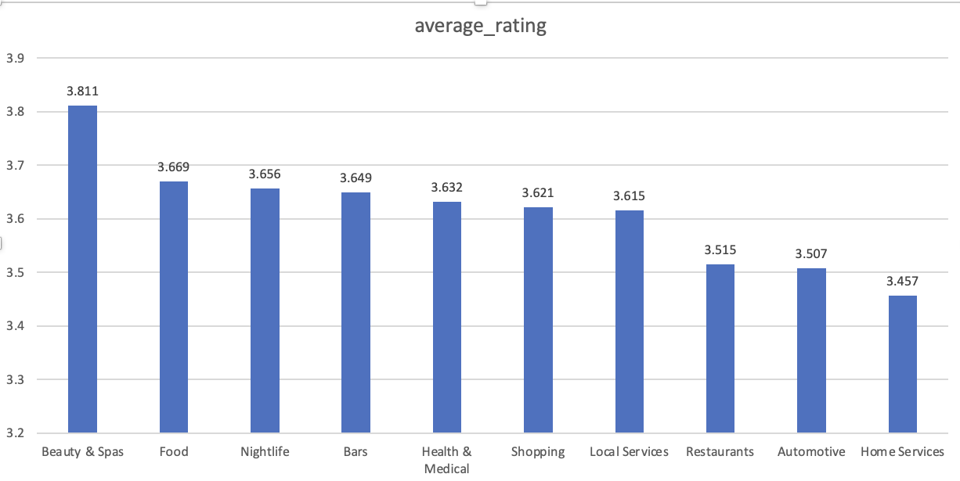
Average rating of the businesses in top ten business categories
Ques 7:- What is the average rating of the businesses in each of those top ten categories?
Answer:- The result indicates the average rating of the businesses in each of the top ten categories which were used in question 6. Beauty spa on the top, followed by Food and the end it is Home Services.

Slide 9
Top five and least 10 funniest restaurant review
Ques 8:- We’re wondering what makes users tag a Restaurant review as “funny”. Can you give us 5 examples of the funniest Restaurant reviews and 5 examples of the 10 least funny? We’d also like you to look at a larger set of funny and unfunny reviews and tell us if you see any patterns that separate the two.
Answer:- Below is the snippet having the top 5 and least 10 funny restaurant review Good Review: Customers provide positive reviews when they appreciate the delicious taste and quality of the food, coupled with attentive and timely service. Additionally, positive comments often highlight the restaurant's value for money, affordability of menu items, inviting ambiance, and attention to detail in presentation, contributing to an overall positive dining experience. Bad Review: Bad Review stem from issues such as poor service, including long wait times and inaccurate orders, as well as complaints about the quality of food, including undercooked or unsatisfactory dishes. Customers may also express dissatisfaction with overcharging, billing problems, an unwelcoming atmosphere, and instances where the restaurant fails to meet expectations set by misleading information about menu items or portion sizes.

Slide 10
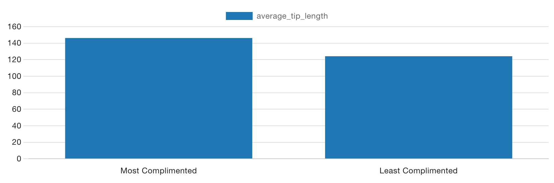
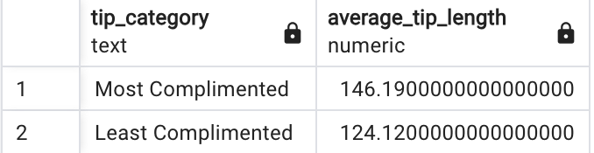
Average length for the 100 most-complimented tips with 100 least-complimented tips
Ques 9:- We think the compliments that tips receive are mostly based on how long the tip is. Can you compare the average length of the tip text for the 100 most-complimented tips with the average length of the 100 least-complimented tips and tell us if that seems to be true?
Answer:- The chart presented below illustrates the comparison between the average lengths of the 100 most complimented tips and the 100 least complimented tips. According to the chart, it is evident that the average length of the 100 most complimented tips exceeds that of the 100 least complimented tips, approximately measuring (147) and (124) respectively.

Slide 11
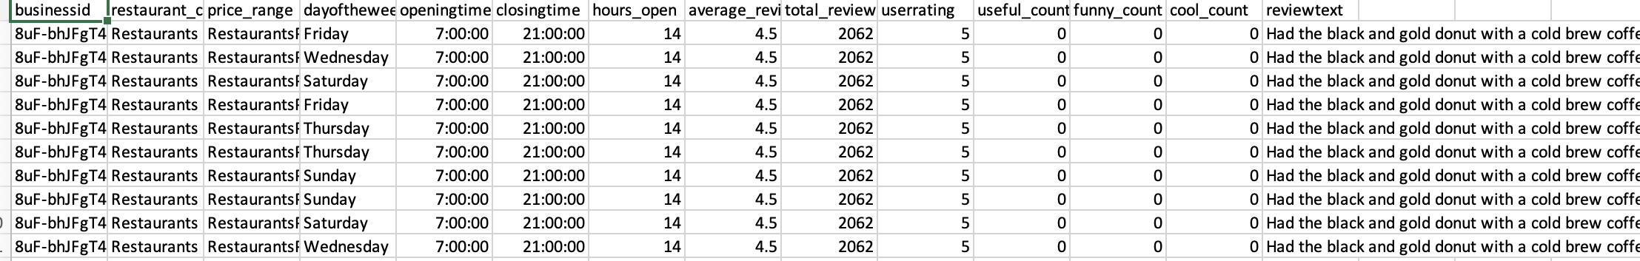
Is restaurant reviews are driven mostly by price range, how many hours the restaurant is open, or the days they are open?
Ques 10:- We are trying to figure out whether restaurant reviews are driven mostly by price range, how many hours the restaurant is open, or the days they are open. Can you please give us a spreadsheet with the data we need to answer that question?
Answer:- Here is an example spreadsheet that includes information on the day of the week, opening hours, average rating received, and price range. By analysing the data in the spreadsheet, we can address the previously mentioned question.

Slide 12
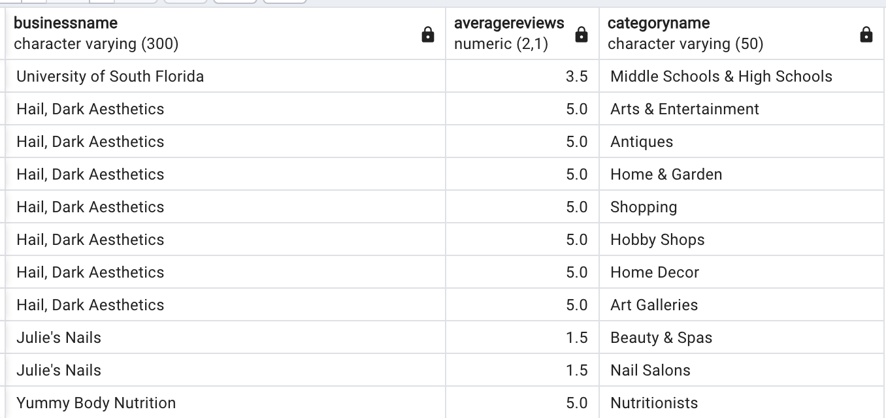
Ques 11:- Fetch the names of businesses along with their average reviews and categories.
Answer:- Here is an excerpt that includes the names of businesses along with the average reviews for each category in which a business operates.

Slide 13
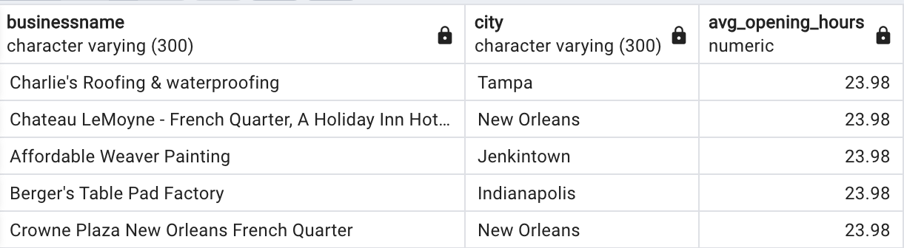
Ques 11:- Identify businesses with the longest average opening hours, including the city they are located in.
Answer:- here is the name of business and location they are operating at which have longest average opening hours.

Slide 14
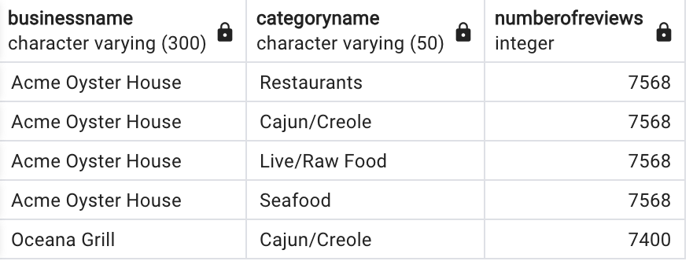
Ques 13:- Retrieve the business names and categories with the highest number of reviews.
Answer:- Below is the business categories with the highest number of reviews. The number of reviews is coming as same because the first four categories belong to only one business.

Slide 15
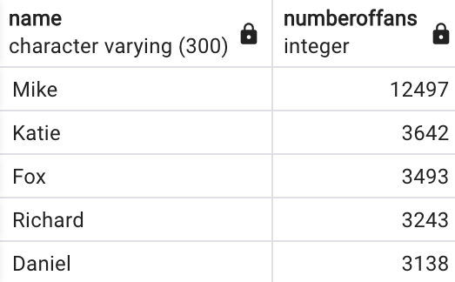
Ques 14:- Find the users who have received the most number of fans
Answer:- Below is the date of the top 5 users who has maximum number of fans.

Slide 16
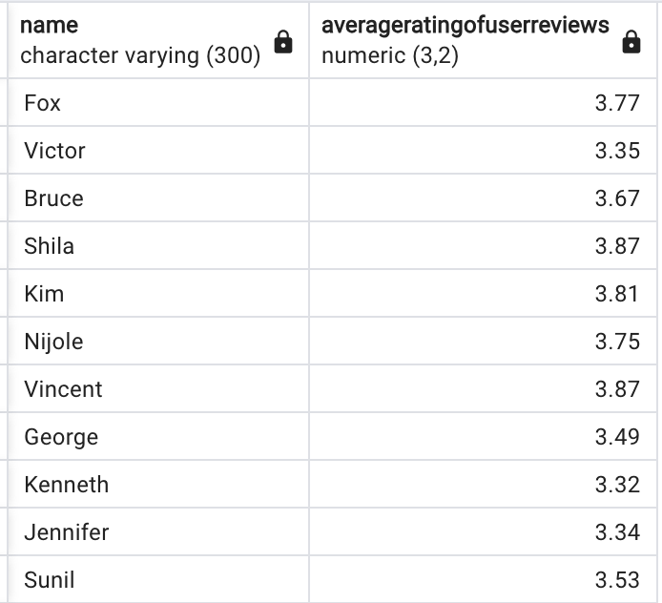
Question 15:- the names and average ratings of users who have left more than 10 reviews.
Answer:- Below is the name of the users who has left more than 10 reviews.

Slide 17
Part 2: Personal Presentation

Slide 18
Question 1:-What was your biggest challenge in working with this data? How did you overcome it?
The major challenge I faced while working with data is:
Data Volume: For the first time I encountered with such a large data set. From the start while creating table for e.g. user table has more than 10 columns and same while loading the data for business reviews which consit 26 files.
Data integrity:- Faced challenge in establishing the foreign keys. Did proper constraints and validations in the application code to ensure that data entered or modified adheres to the defined relationships and constraints.
Data cleaning: Ensuring that data entered into the database is accurate and follows a consistent format.Have to drop and recreate the table several time due to failure. The data validation at the application level before inserting or updating records. Use regular expressions, constraints, and input validation to enforce data quality.

Slide 19
Question 2:- What was the easiest part of the project ?
The following are the parts of the project which I found easy:-
Assigning Primary Keys: Managing primary keys was relatively straightforward because only three tables required unique keys. This made it easier to assign primary keys, especially considering their availability as foreign keys in other tables.
Creating Bar Charts: The built-in functions of PostgreSQL simplified the process of creating bar charts. Leveraging these functions, I was able to generate visual representations based on the queried data, providing a convenient way to analyse and present information.
Loading Data: Dealing with large datasets was made more manageable through the use of the CSV command. This command facilitated the efficient loading of substantial amounts of data into the database, streamlining the overall data handling process.

Slide 20
Question 3:- Was there anything that surprised you about the data?
Yes, following are thing that surprised:-
Data Cleaning Challenges: The data exhibited challenges related to cleanliness. Notably, names were found in both English and Chinese languages, and certain entries contained special characters. This variability in linguistic representation could pose challenges during analysis and presentation.
Unexpected Complexity in Business Attributes: The 'business attributes' table revealed a surprising level of complexity. For instance, the representation of Business Parking as {'garage': False, 'street': False, 'validated': False, 'lot': True, 'valet': False} introduces nuanced details that may impact the interpretation of results. The intricacies in attribute representation were unexpected and added a layer of complexity to the dataset.

Slide 21
Question 4:-Is there anything you wonder about how Yelp’s real data might look, how their database systems are designed, or what they do with this kind of data?
Yes, how and what make yelp capable of handling such large amount of data along with the smooth interaction between the users. Yelp is playing an important role, by keeping the data of user rating and reviews the business get from users enabling the public to get the idea of services the business offers.

Slide 22
Question 5:- Are there any changes you would recommend to Yelp to make this data easier to work with?
Standard language: it is important to have standard outlet in which the data is accepted for eg names It should be accept only name in one language, like business attribute it should only accept values in form of Boolean i.e.( True or False) if any other datatype is provided it should raise the error.
Data Cleaning : there should be regular run must be there to do the data cleaning for example is there is special character in names or invalid data is should be send for validation.
User-Friendly Data Documentation: Provide comprehensive and user-friendly documentation for the dataset. This should include details on the data cleaning process, any language variations, and the interpretation of complex attribute representations. Clear documentation would assist analysts and developers in understanding and working with the dataset more effectively.

